Slide 1

other side to- FEMICIDE
Understanding the causes, consequence and solutions

Slide 2
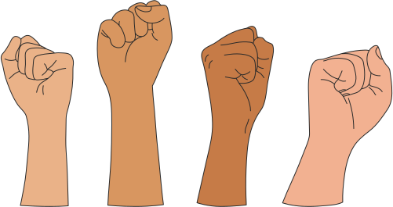
WHAT IS FEMICIDE?
Femicide is intentional killing of a women becose of her gender.
"The killing of a women because she is a womenis not jist a tragedy-ot is a crime against humanity"

Slide 3
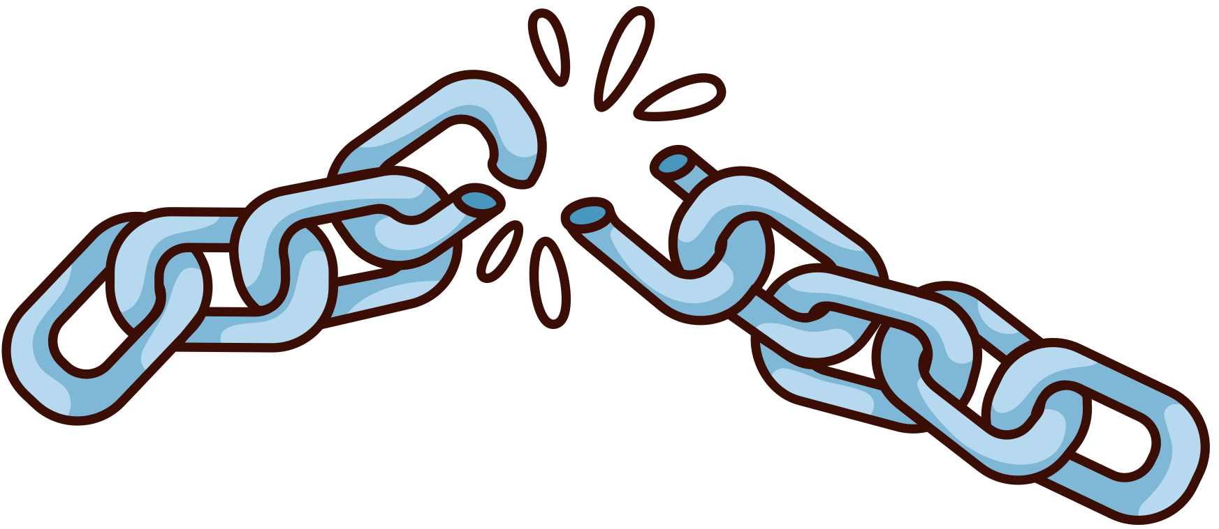
SOCIAL CAUSES AND ISSUES
Normalization of violance
Lack of legal protection
Misogyny in society
"Femicide begins where justice ends"

Slide 4

CONSEQUENCES OF FEMICIDE
Destrocution of families qnd communities
Physiological trauma for surviros and families
Long lasting social and economic impacts
"When we lose on women, the whole community loses a part of itself"

Slide 5

HOW CAN WE HELP?
"Every voice can be step toward justice"
Education and awareness
Support for survivors
Legislative changes
"Change becomes with edu ation and awareness"

Slide 6

VOICE FOR CHANGE
Together we can stand against femicide
Educate
Support
Act
"We must not stay silent. A voice against femicide os a voice for life"

